Slide 1
Teddy Bears’ Picnic
Build
a home for the animals
using
P A W S
Thalgarrah Environmental Education Centre

Slide 2
Things you need
White A4 card (background)
Green tissue paper (grass)
Blue tissue paper (sky)
White facial tissues (clouds)
Bright coloured tissue paper (yellow or red) (flowers)
Brown painted paper with tree/bark texture (1/2 A4) (tree branches)
Green painted paper with foliage texture (1/2 A4) (tree foliage and shrub)
Cut out clip art of Australian animals (eg. butterfly, lizard, kangaroo, bird, etc.)
Watered down PVA glue
Broad paintbrush
Thalgarrah Environmental Education Centre

Slide 3
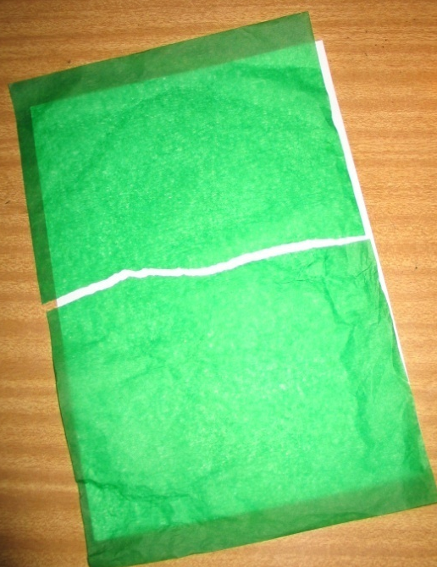
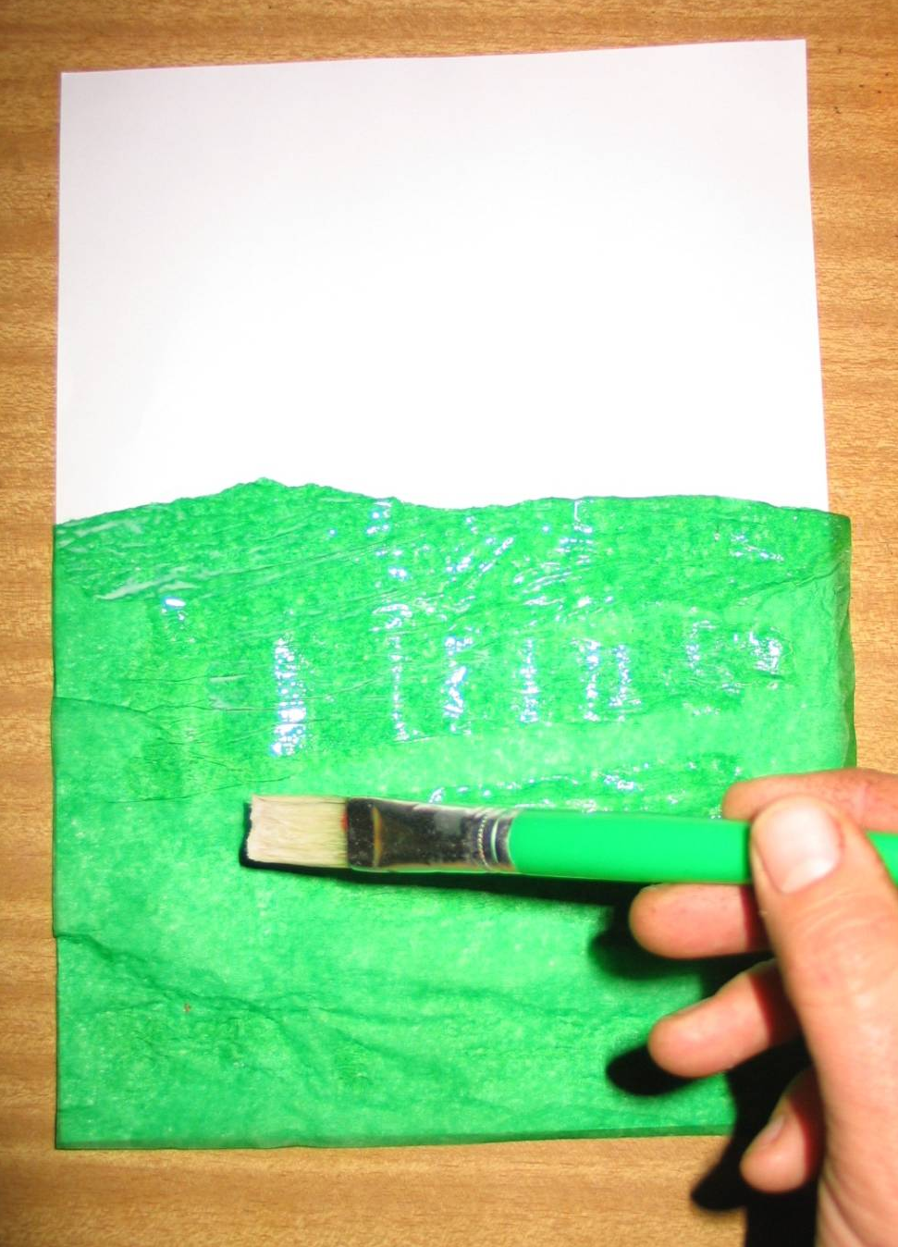
Tear the green piece of tissue paper to fit over half the A4 cardboard.
Paint the bottom half of the cardboard with the glue mix.
Place the tissue paper onto the glued area and paint over the tissue paper with the glue mix.
Thalgarrah Environmental Education Centre

Slide 4
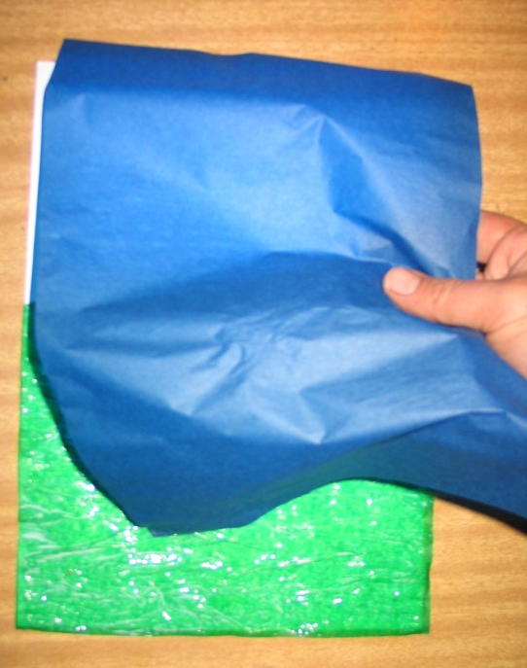
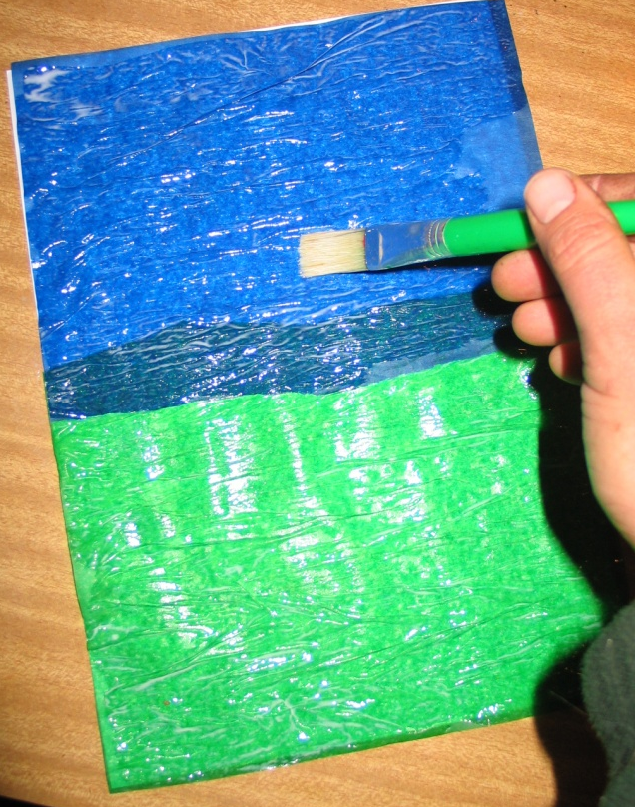
Tear the blue piece of tissue paper to fit over the top half the A4 cardboard.
Paint the top half of the cardboard with the glue mix.
Place the blue tissue paper onto the glued area and paint over the tissue paper with the glue mix.
Thalgarrah Environmental Education Centre

Slide 5
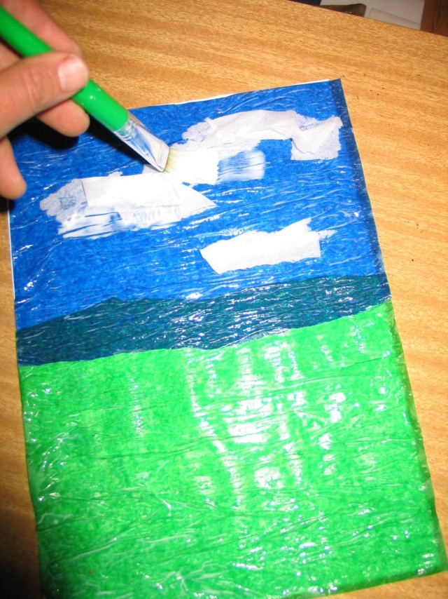
Tear a tissue and scrunch the pieces. Glue the pieces onto the blue area.
Paint over the white tissue paper with the glue mix.
Thalgarrah Environmental Education Centre

Slide 6
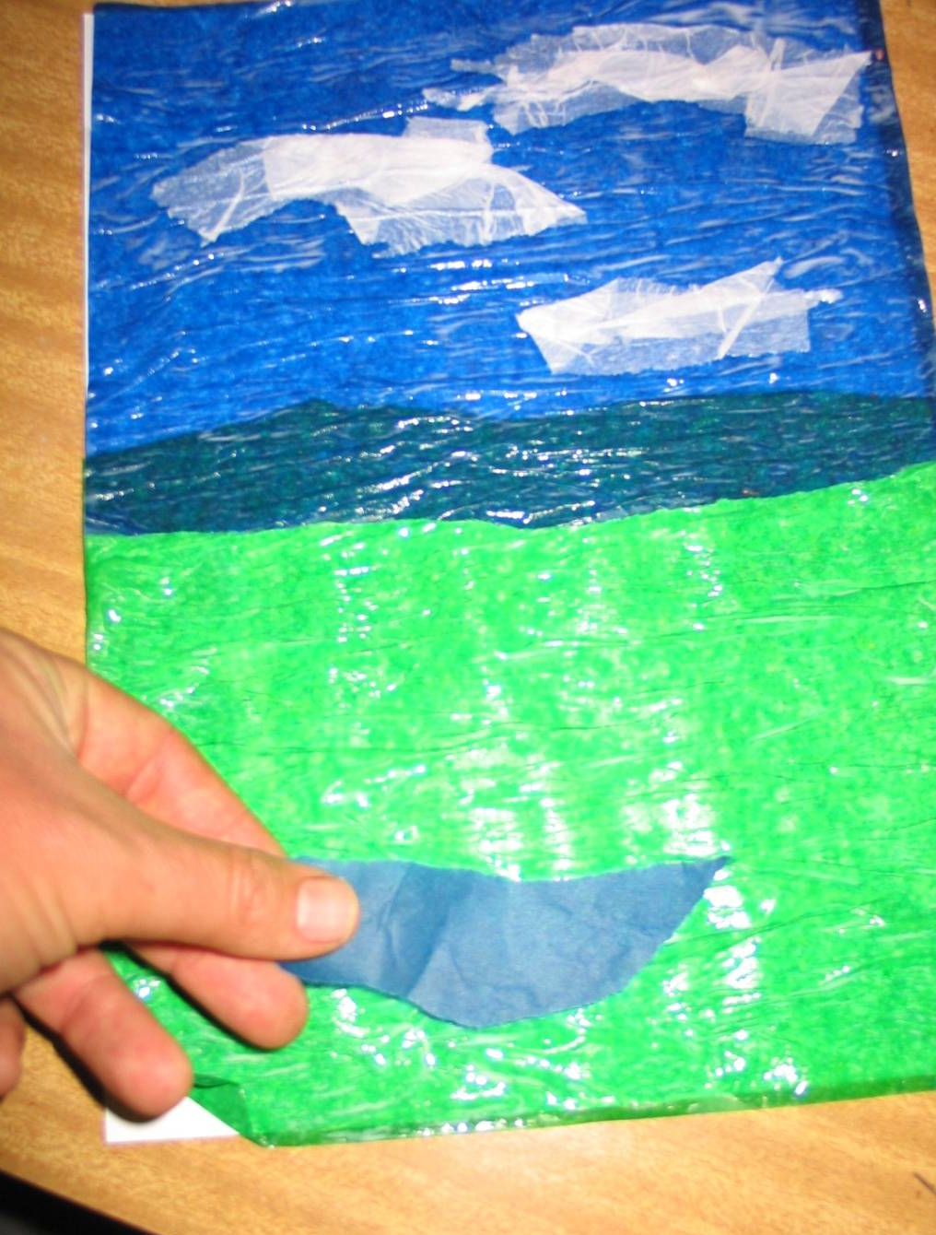
Tear a piece of blue tissue and glue onto the lower part of the green area. This will be a pond.
Paint over the blue tissue paper with the glue mix.
Thalgarrah Environmental Education Centre

Slide 7
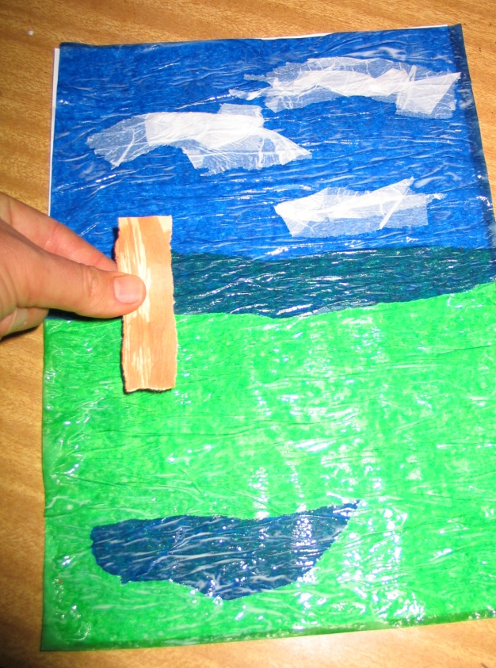
Tear 2 skinny pieces of the brown painted paper and glue onto the higher part of the green area. These will be the trunks of trees.
Paint over the pieces of the brown paper with the glue mix.
Thalgarrah Environmental Education Centre

Slide 8
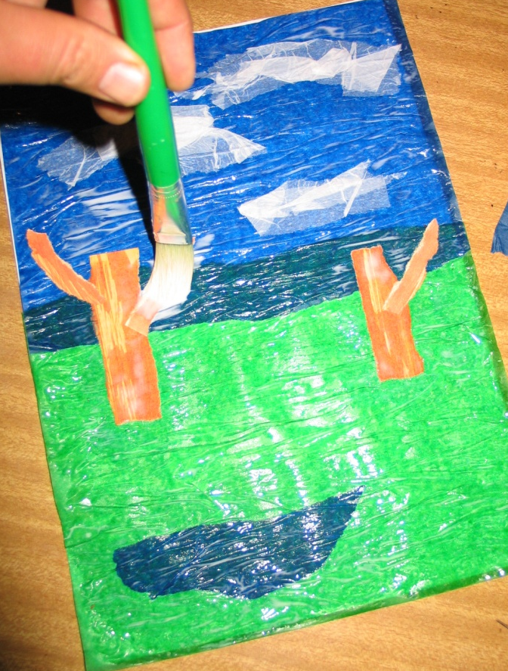
Tear some really skinny pieces of the brown painted paper and glue onto the trunks. These will be branches of the trees.
Paint over the branches with the glue mix.
Thalgarrah Environmental Education Centre

Slide 9
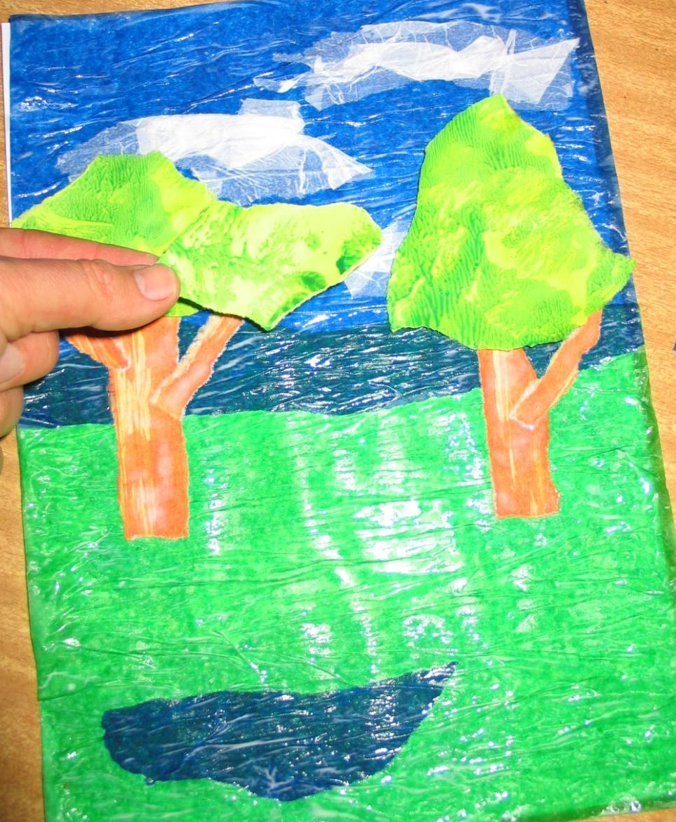
Tear some pieces of the green painted paper and glue onto the top of the trunks and branches. This will be the leaves of the trees.
Paint over the leaves with the glue mix.
Thalgarrah Environmental Education Centre

Slide 10
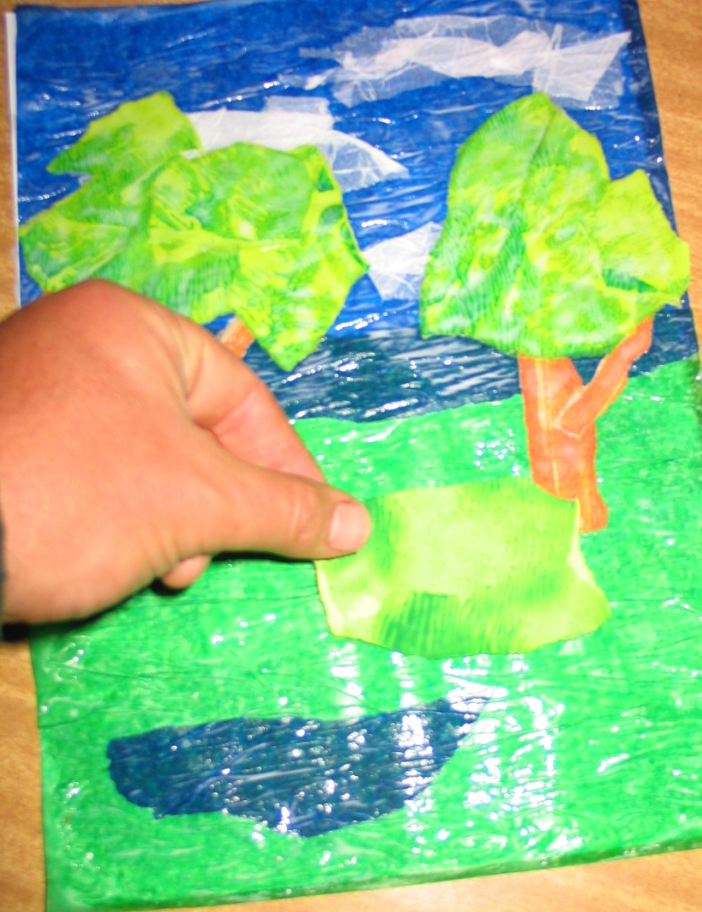
Tear a piece of the green painted paper and glue onto the grass area. This will be the shrub.
Paint over the shrub with the glue mix.
Thalgarrah Environmental Education Centre

Slide 11
Tear some small pieces of coloured tissue paper and scrunch them up. Glue onto the shrub as flowers.
Paint over the flowers with the glue mix.
Thalgarrah Environmental Education Centre

Slide 12
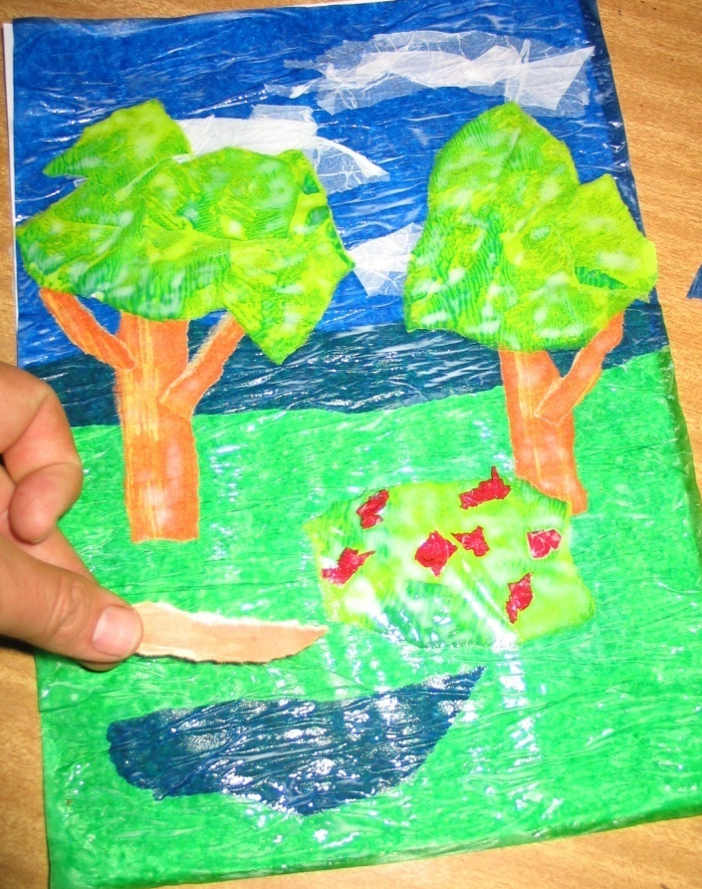
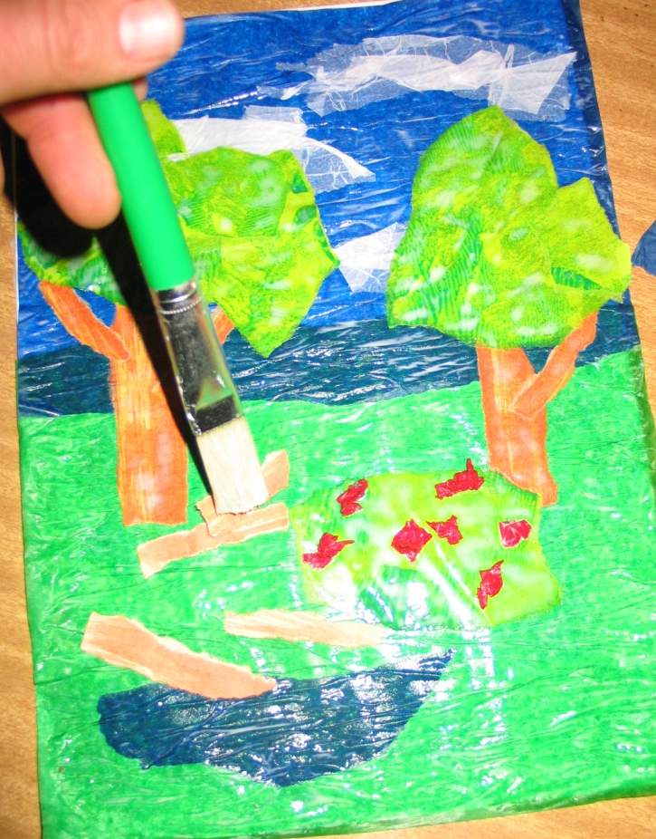
Tear some skinny pieces of the brown painted paper and glue onto the green area. These will be logs on the ground.
Paint over the pieces of the brown paper with the glue mix.
Thalgarrah Environmental Education Centre

Slide 13
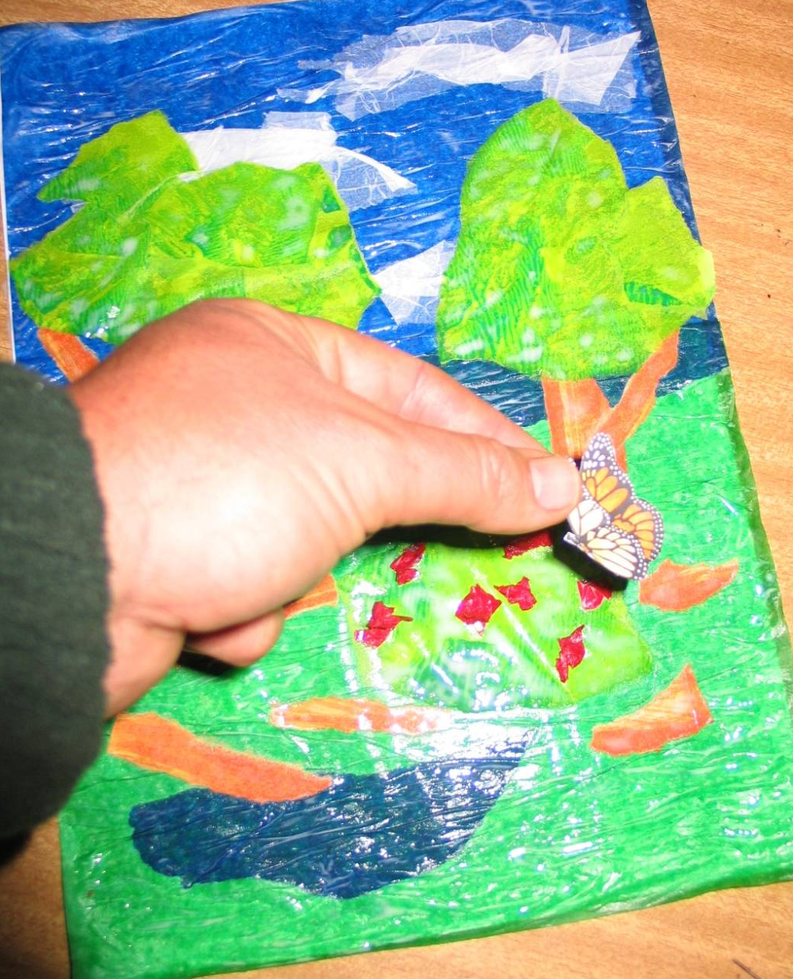
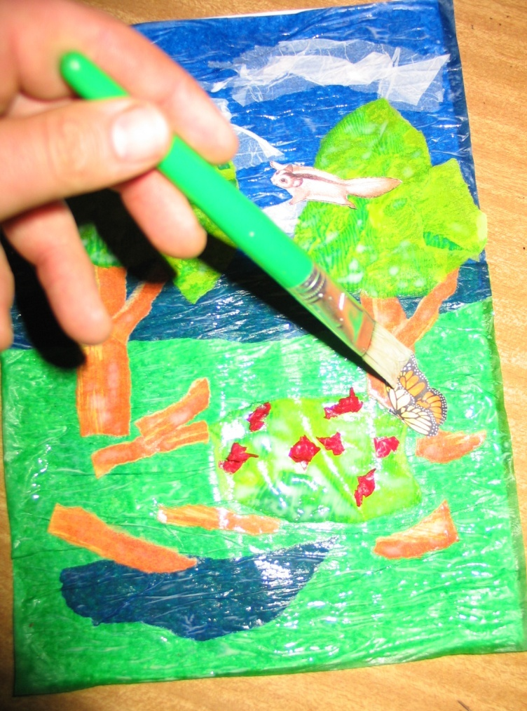
Place the cut out animals into the scene.
Paint over the animals with the glue mix.
Thalgarrah Environmental Education Centre

Slide 14
FINISHED!
Thalgarrah Environmental Education Centre

